Slide 1
World Terrorism

Slide 2

Terrorism refer to violent acts which are intended to create fear. They may be done for a religious, political, or ideological goal, and uses illegal violence.

Slide 3
Why to analyze the dataset?
Analyzing the dataset and making patterns from the data gives us the solution to get out of the problem.
What to analyze?
The given source dataset contains the records of the activity of the terrorist in the world from 1970 to 2017.
The dataset depicts the people killed at different locations in different attack types and target types.

Slide 4
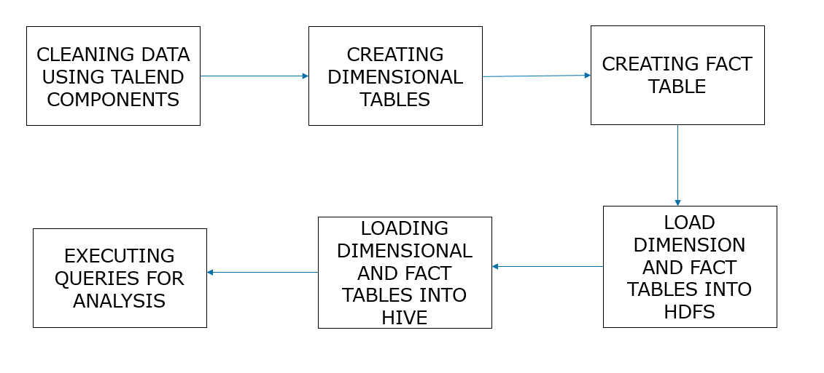
FLOW CHART:

Slide 5
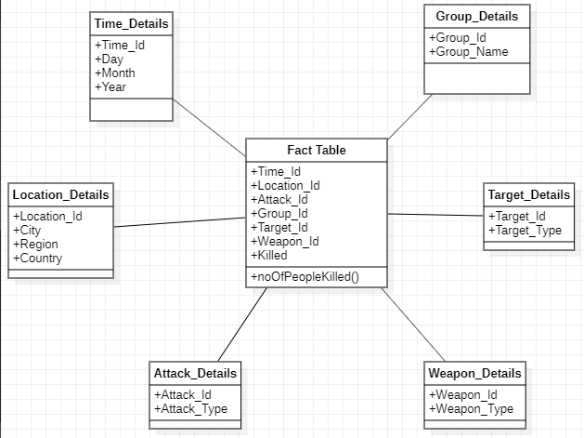
DATA MODEL:

Slide 6
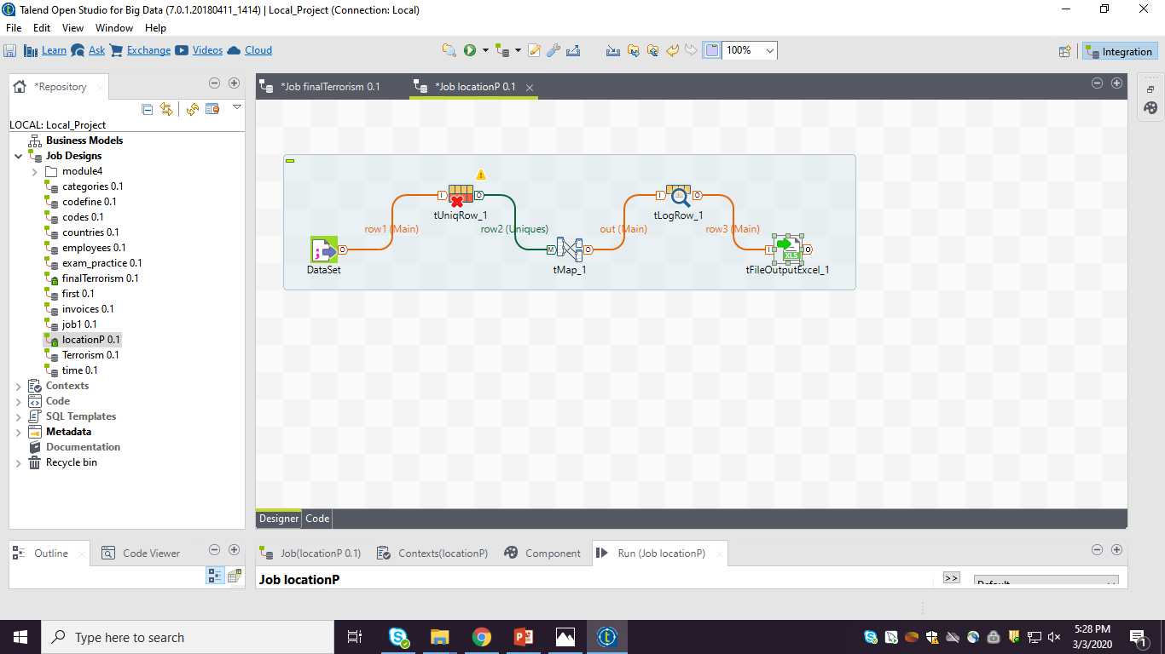
CREATING DIMENSIONAL TABLE:

Slide 7
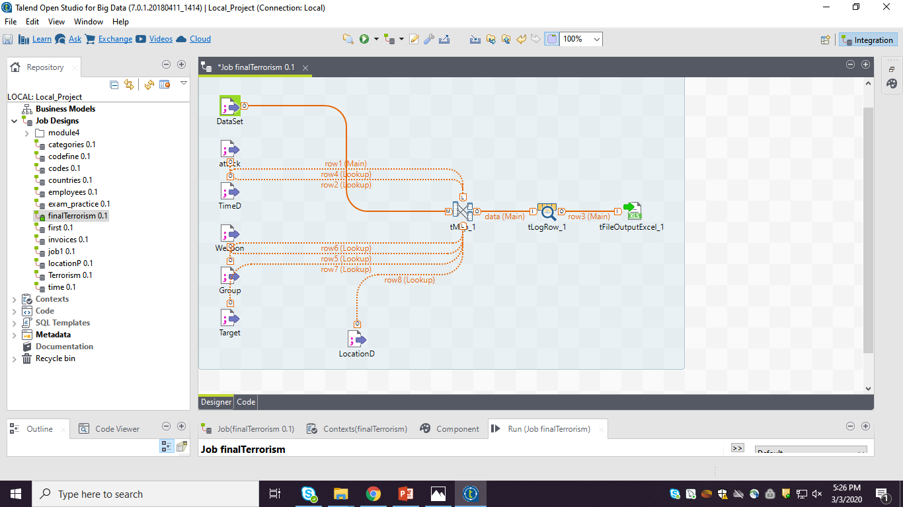
CREATING FACT TABLE:

Slide 8
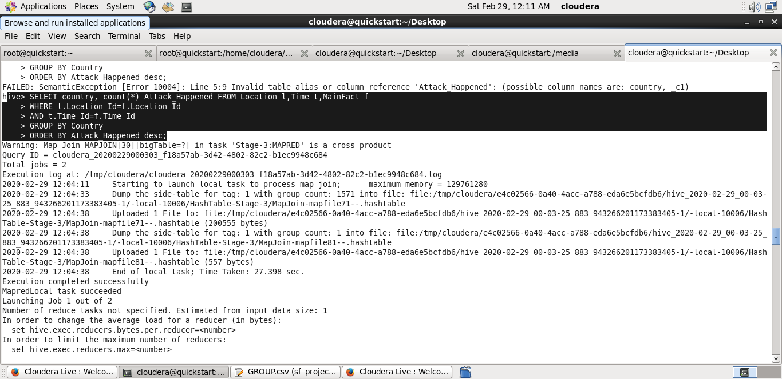
COUNTRY-WISE DEATH FREQUENCY CAUSED BY TERRORISM

Slide 9
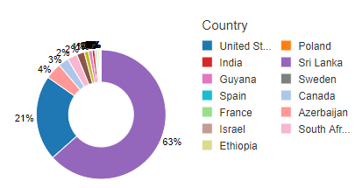
Below graph depicts the highest killed country in terrorist activities:

Slide 10
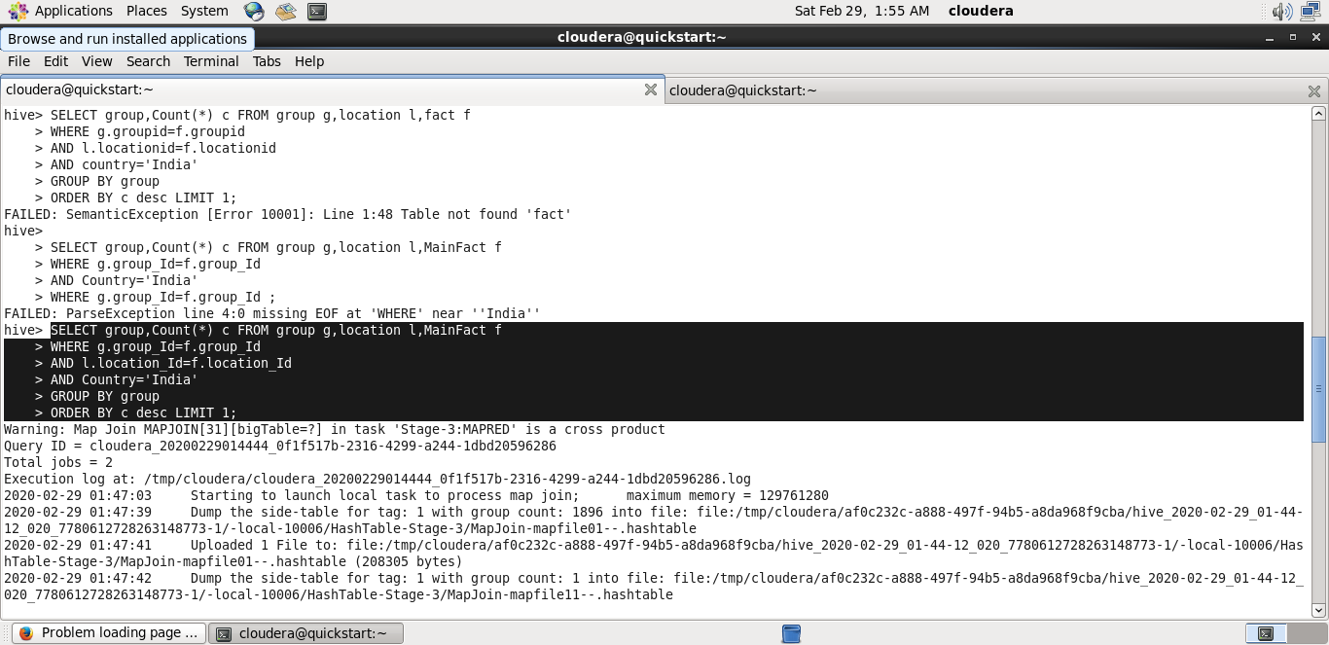
GROUP-WISE DEATH FREQUENCY CAUSED BY TERRORISM

Slide 11
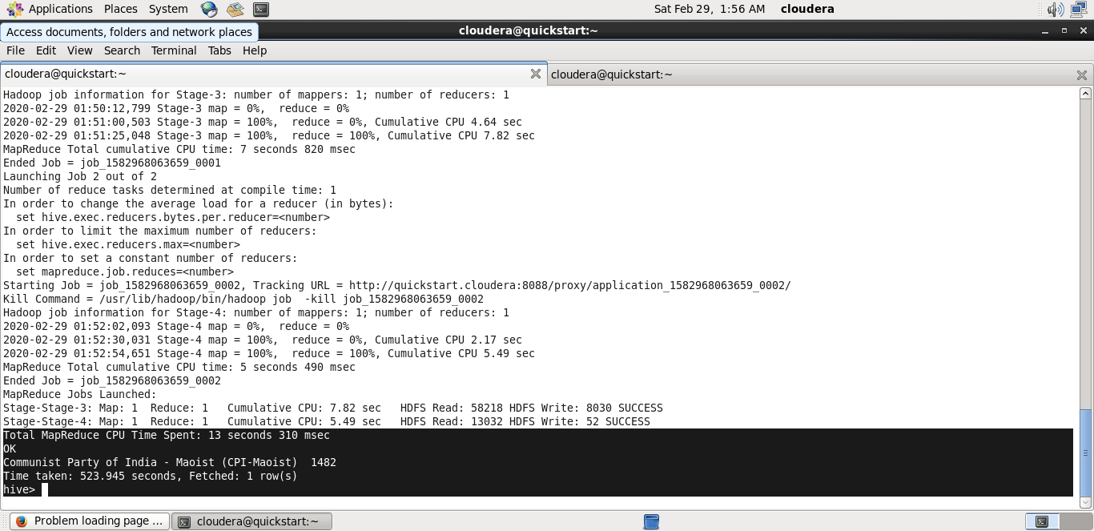
QUERY OUTPUT:

Slide 12
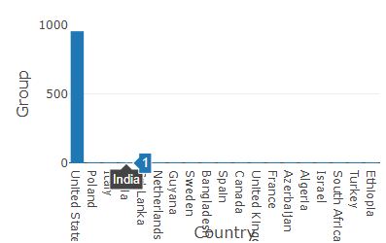
Below graph depicts the countries with number of groups in terrorist activities:

Slide 13
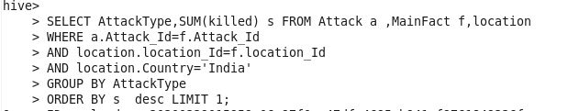
ATTACK-WISE DEATH FREQUENCY CAUSED BY TERRORISM

Slide 14

QUERY OUTPUT:

Slide 15
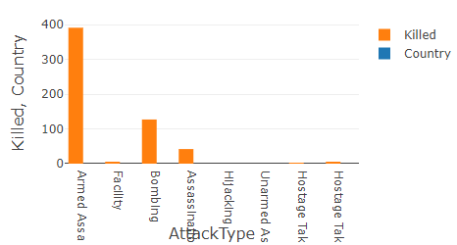
Below graph depicts the highest killed in attack type terrorist activities:

Slide 16

DISTINCT COUNTRIES

Slide 17
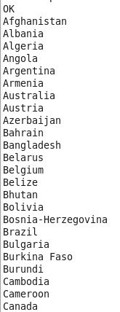
Query Output:

Slide 18
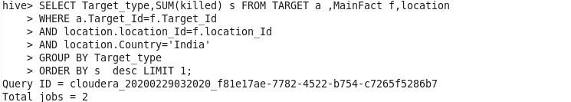
TARGET-WISE DEATH FREQUENCY CAUSED BY TERRORISM

Slide 19
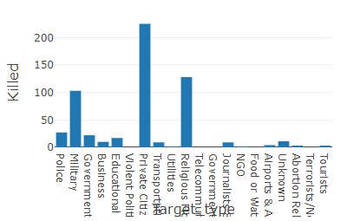
Below graph depicts the highest killed in target type terrorist activities:

Slide 20


Slide 21



